Slide 1
Introduction to Predictive Analytics
Introduction to Analyzing Data for Business Goals

Slide 2
Learning Goals
Evaluate a scenario and discuss the optimal predictive modeling technique(s) to achieve business goals.
Investigate considerations for how predictive analytics will help you solve the business problem for your final project.
Define predictive analytics and the techniques of predictive analytics.

Slide 3
Predictive Analytics
What is predictive analytics?
Your model’s “goodness” is measure by how it scores on new data
Ex. Student practice exams VS final exam

Slide 4
Example Questions Across Industry
Field | Descriptive Analytics | Diagnostic Analytics | Predictive Analytics | Prescriptive Analytics
Healthcare | How many patients went to the hospital/clinic last week? | Why did these patients go to the hospital? | Which patient is likely to need hospitalization? | Extra home treatment to prevent visits
Life science | What are the total medicines available by pharmaceuticals? | Why do we not have more medicines or pharmaceuticals? | Which pharmaceutical is likely to monopolize the production of medicines? | Increase the number of pharmaceuticals and medicines
Finance | Where was the stock market in the last 6 months? | Why was the stock market that high/low? | What will the level be for the stock market in the next 6 months? | Reduce downside risk by diversifying a portfolio
Politics | Who was elected last? | Why were they elected? | Who will be elected next? | Increase voter education to reduce downside societal impact
Education | How many students are learning online? | Why are they taking courses online? | How many more courses are needed to support them? | Increase the number of courses
Non-profit | How are non-profits independent? | Why are they effective? | How many more non-profits can be created? | Decrease barriers to creating non-profits
Human rights | What is the number of refugees in the world? | Why are there so many refugees? | What are the likely future sources of refugees? | Reduce colonialism, imperialism, 'isms and let people live

Slide 5
Business Questions to Answer
How will sales change over the next year?
What trends in fashion and style will be popular next spring?
How likely is this customer to pay back their loan?
Should I insure this new driver?
Should I extend a loan to a young couple with no credit history?
…
…
…
…
…
…

Slide 6
Predictive Analytics - Techniques & Methodologies
Supervised Learning
Unsupervised Learning

Slide 7
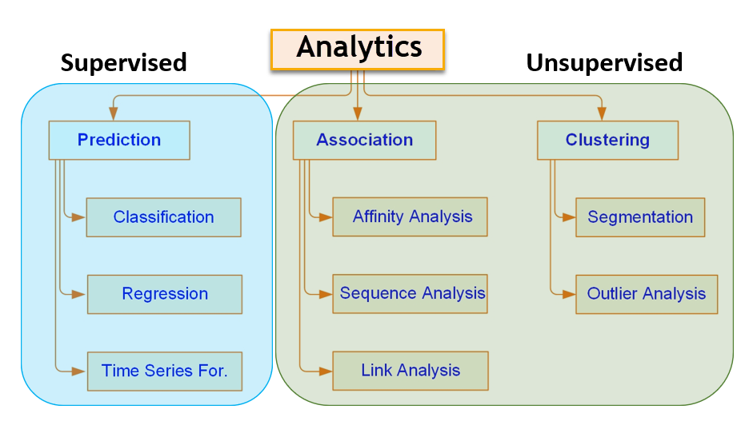
Supervised vs Unsupervised Learning
Machine learning is used to discover variety of patterns with supervised and unsupervised learning

Slide 8
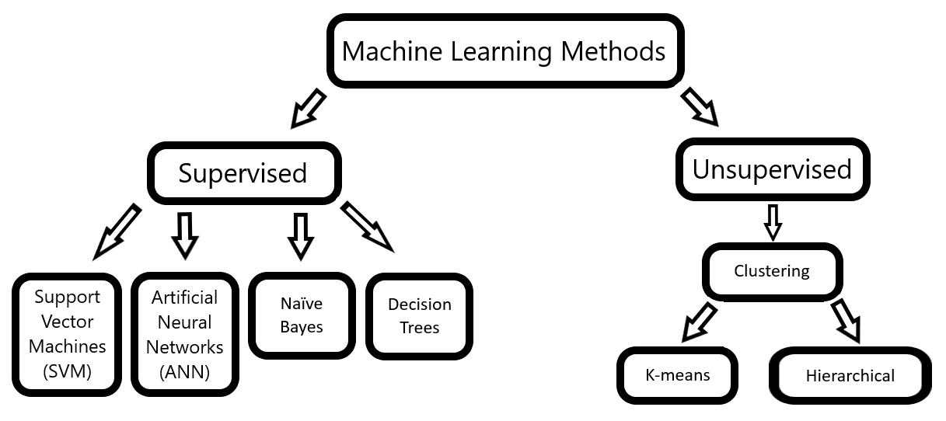
Machine Learning Methods

Slide 9
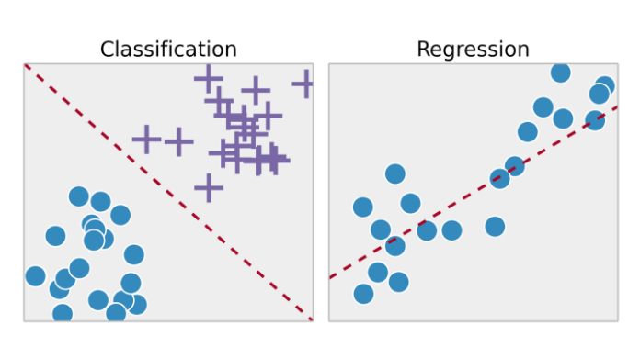
Predictive Analytics - Techniques & Methodologies
Types of Supervised Learning: Classification & Regression

Slide 10
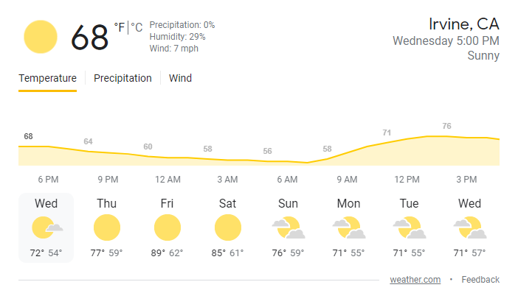
Regression VS Classification
Regression
Question: What is the temperature going to be tomorrow?
Answer: 78 Degrees

Slide 11

Regression VS Classification
Classification
Question: Will it be Cold or Hot Tomorrow?
Answer: HOT

Slide 12
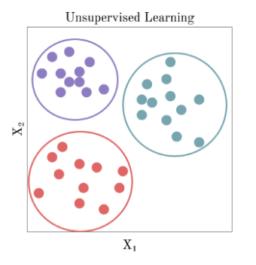
Predictive Analytics - Techniques & Methodologies
Unsupervised Learning: Clustering

Slide 13
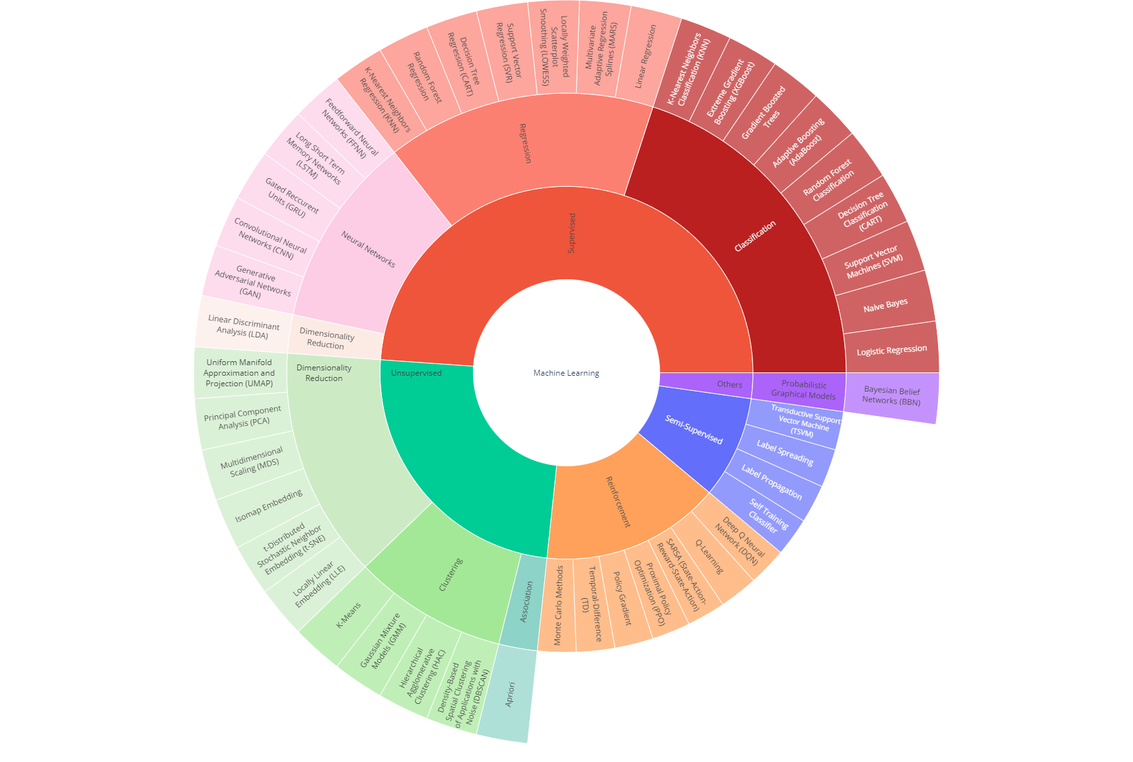
Good Reference
https://towardsdatascience.com/linear-regression-made-easy-how-does-it-work-and-how-to-use-it-in-python-be0799d2f159
Notes:
plotly
https://towardsdatascience.com/linear-regression-made-easy-how-does-it-work-and-how-to-use-it-in-python-be0799d2f159

Slide 14
Business Challenges
Error-Prone Data
Bias-Variance Tradeoff
Underfit
Overfit
Interpretation & Subjectivity

Slide 15
Bias-Variance Tradeoff (BVT)
Bias – Difference between a model’s prediction and the truth (the actual values)
Training error
High bias - poor modeling (very little patterns are captured), underfitting, due to lack of representation
Variance – variability of a model’s prediction between training and test data sets
Test/validation error
High variance – poor modeling (capturing signal and noise in data), overfitting, due to overrepresentation
Ideal case: low bias and low variance

Slide 16
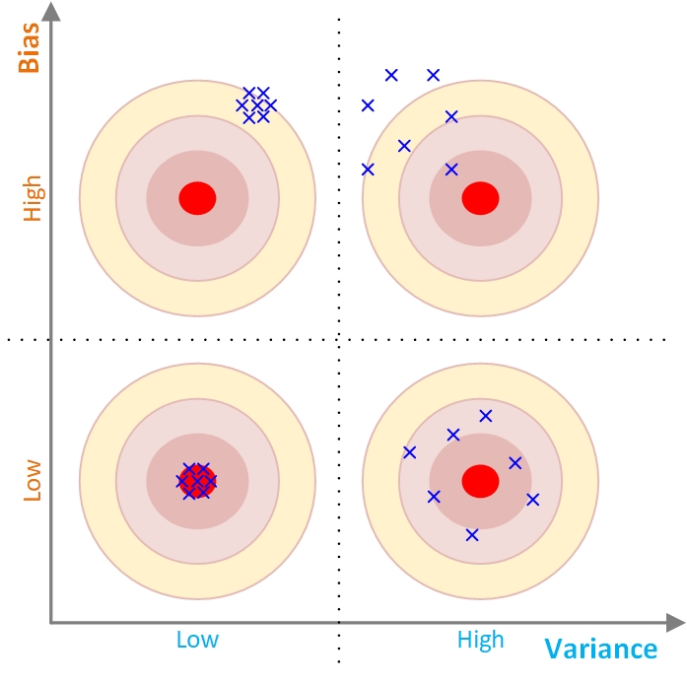
Bias-Variance Tradeoff (BVT)
Tradeoff is between accuracy and consistency
We want to be consistently accurate (the quadrant with low bias and low variance)

Slide 17
Business Challenges
Underfit: An underfit model is unable to accurately predict variations in the output. You would realize this when applying the model to a test dataset.
For example, suppose you develop a model designed to predict an automobile’s gas mileage given its weight. Light cars have higher gas mileage while heavy cars have lower gas mileage. If your model shows little variation in its predictions regardless of the cars’ weight, it is probably underfitting.

Slide 18
Business Challenges
Overfit: In contrast, an overfit model shows variations in the output that are not actually present.
Again, you would realize this when applying the model to a test dataset.
For instance, suppose you’re developing a model designed to predict a person’s income tax given their income. An overfit model manages to correctly predict each data point. However, this doesn’t necessarily mean that it would be accurate for “new” data (data that the model hasn’t previously “seen”).

Slide 19
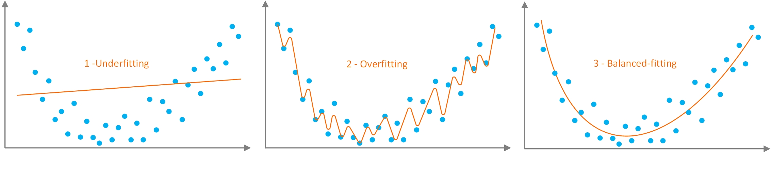
Bias-Variance Tradeoff (BVT)
Overfitting/training vs underfitting/training
The goal is to capture the signal and stop the learning before starting to capture the noise.
Generalizability is needed for predictability
Prediction vs curve-fitting

Slide 20
Linear Regression (LR)
Correlation
Relationship between variables (X,Y)
Variables move together
X, Y can be interchanged
Relation is represented by a point
Regression
One variable affects another (X,Y)
Cause and effect
X,Y cannot be interchanged
Relation is represented by a line
Notes:
Predicting taxi fare based on distance traveled
Predicting rainfall based on time of the year and location
Predicting the homicide rate in the area based on income level and the prevalence of gun ownership
Correlation (the relationships)
Regression (the mathematics behind the relationship)

Slide 21
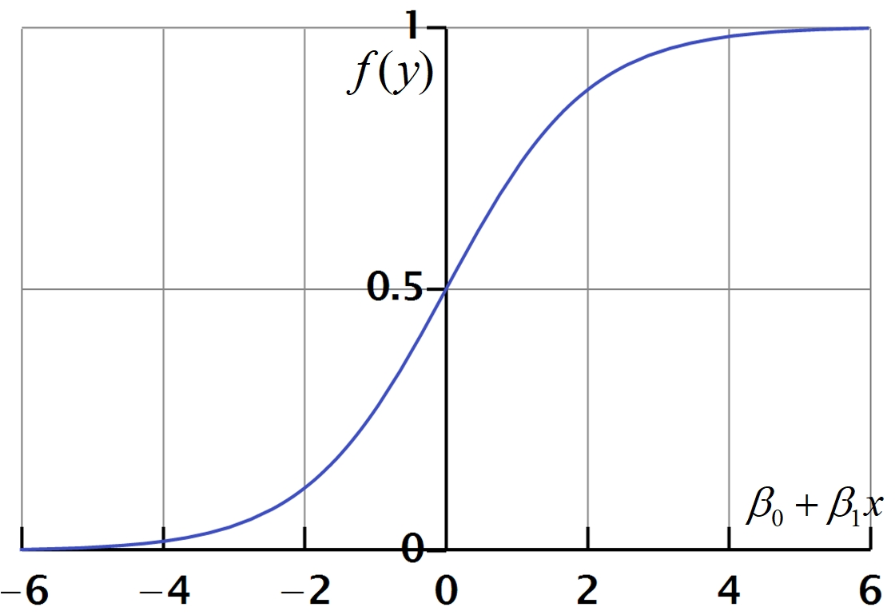
Logistic Regression
Most popular statistical technique for classification type prediction problems
Developed in 1940s
It calculates the probability of the outcomes
Notes:
To predict whether an email is spam (1) or (0)
Whether the tumor is malignant (1) or not (0)

Slide 22

Introduction to Decision Trees
Most common & highly intuitive classifiers
Tree induction/creation follows a divide-and-conquer methodology
Can use both numeric and nominal variables

Slide 23

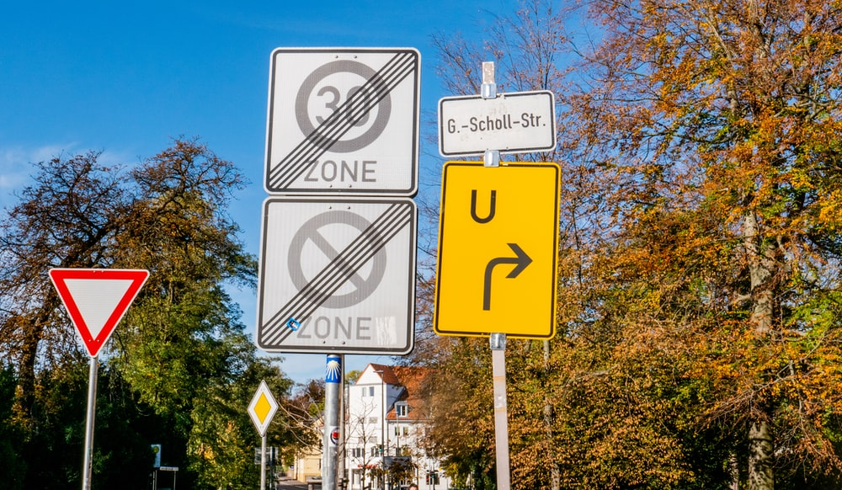
Evaluating a Decision Tree Model
Accuracy score:
Used to calculate the accuracy of the trained classifier.
Confusion Matrix:
Used to understand the trained classifier behavior over the test dataset or validate dataset.

Slide 24

Decision Trees vs. Random Forest
A single tree versus whole a lot of trees
Random Forest (RF) = Model Ensemble of Many Trees
The idea is to build random trees using random cases and variables
The prediction is made by all the trees following majority voting procedure
RF produces more robust and reliable prediction results

Slide 25

Assessment Metrics for Prediction Models
Prediction accuracy
Interpretability
Model transparency
Mitigating the “black-box” perception
Speed
Development & Deployment
Robustness
Scalability

Slide 26
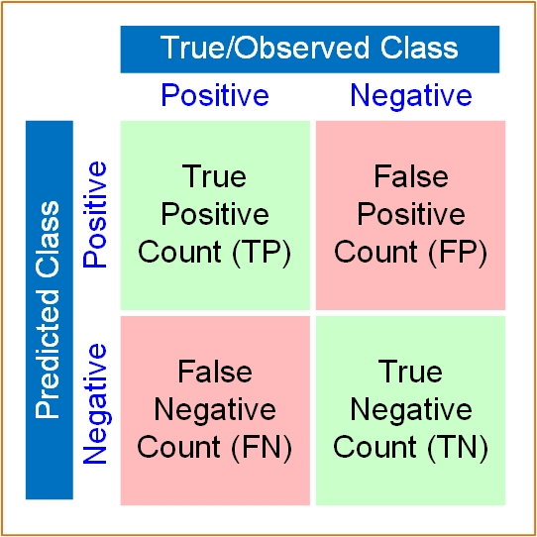
Estimating Accuracy of Classification Models
Confusion matrix
For binary classification problems, it is a simple 2 x 2 cross tabulation of actuals and predictions

Slide 27
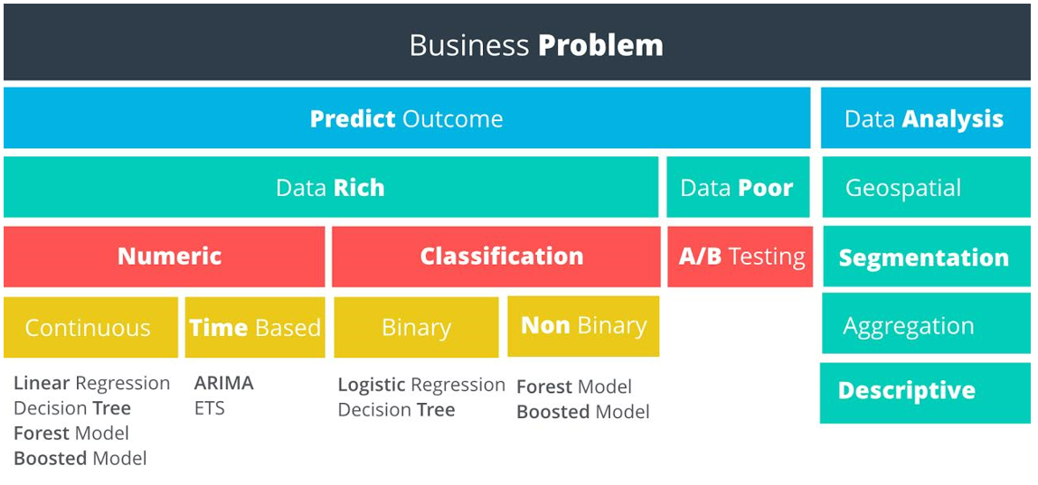
Problem Solving Paradigm

Slide 28
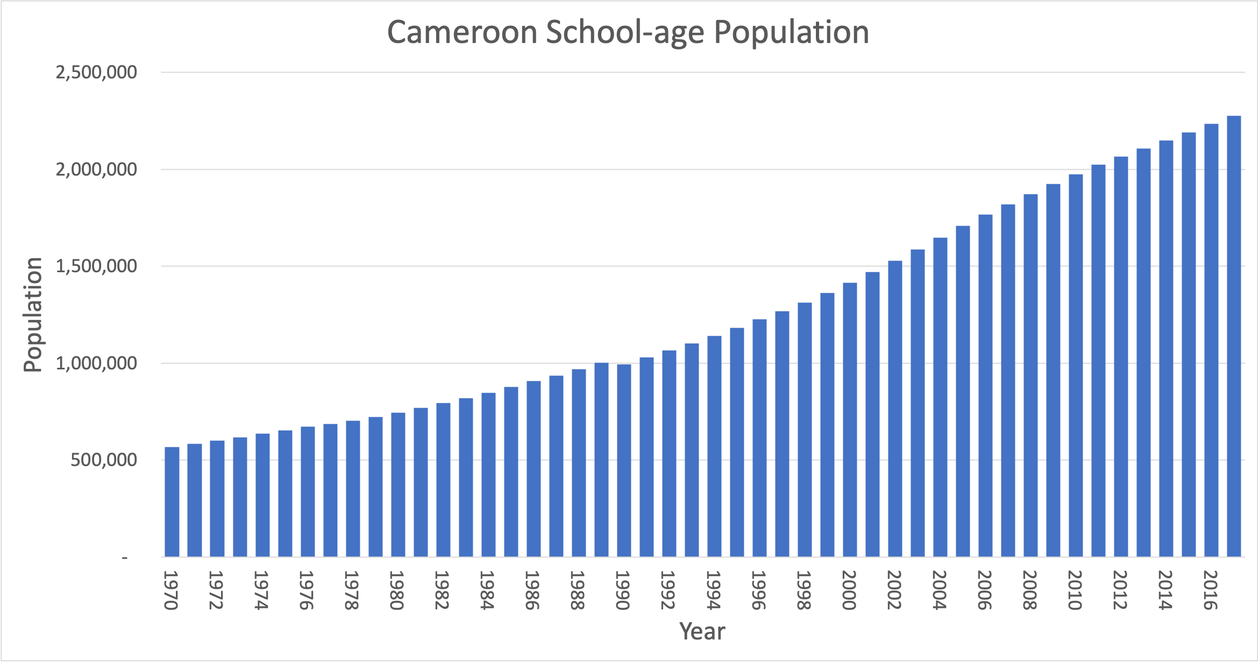
Achieving Business Goals with Predictive Analytics
Discussion: Consider education in the country of Cameroon. If you are a government official responsible for ensuring that schools have sufficient resources, it would obviously be very useful to be able to predict the number of school-age children that could potentially be attending school in the future so you can ensure that resources are available.
Figure 5: School-age population for Cameroon

Slide 29
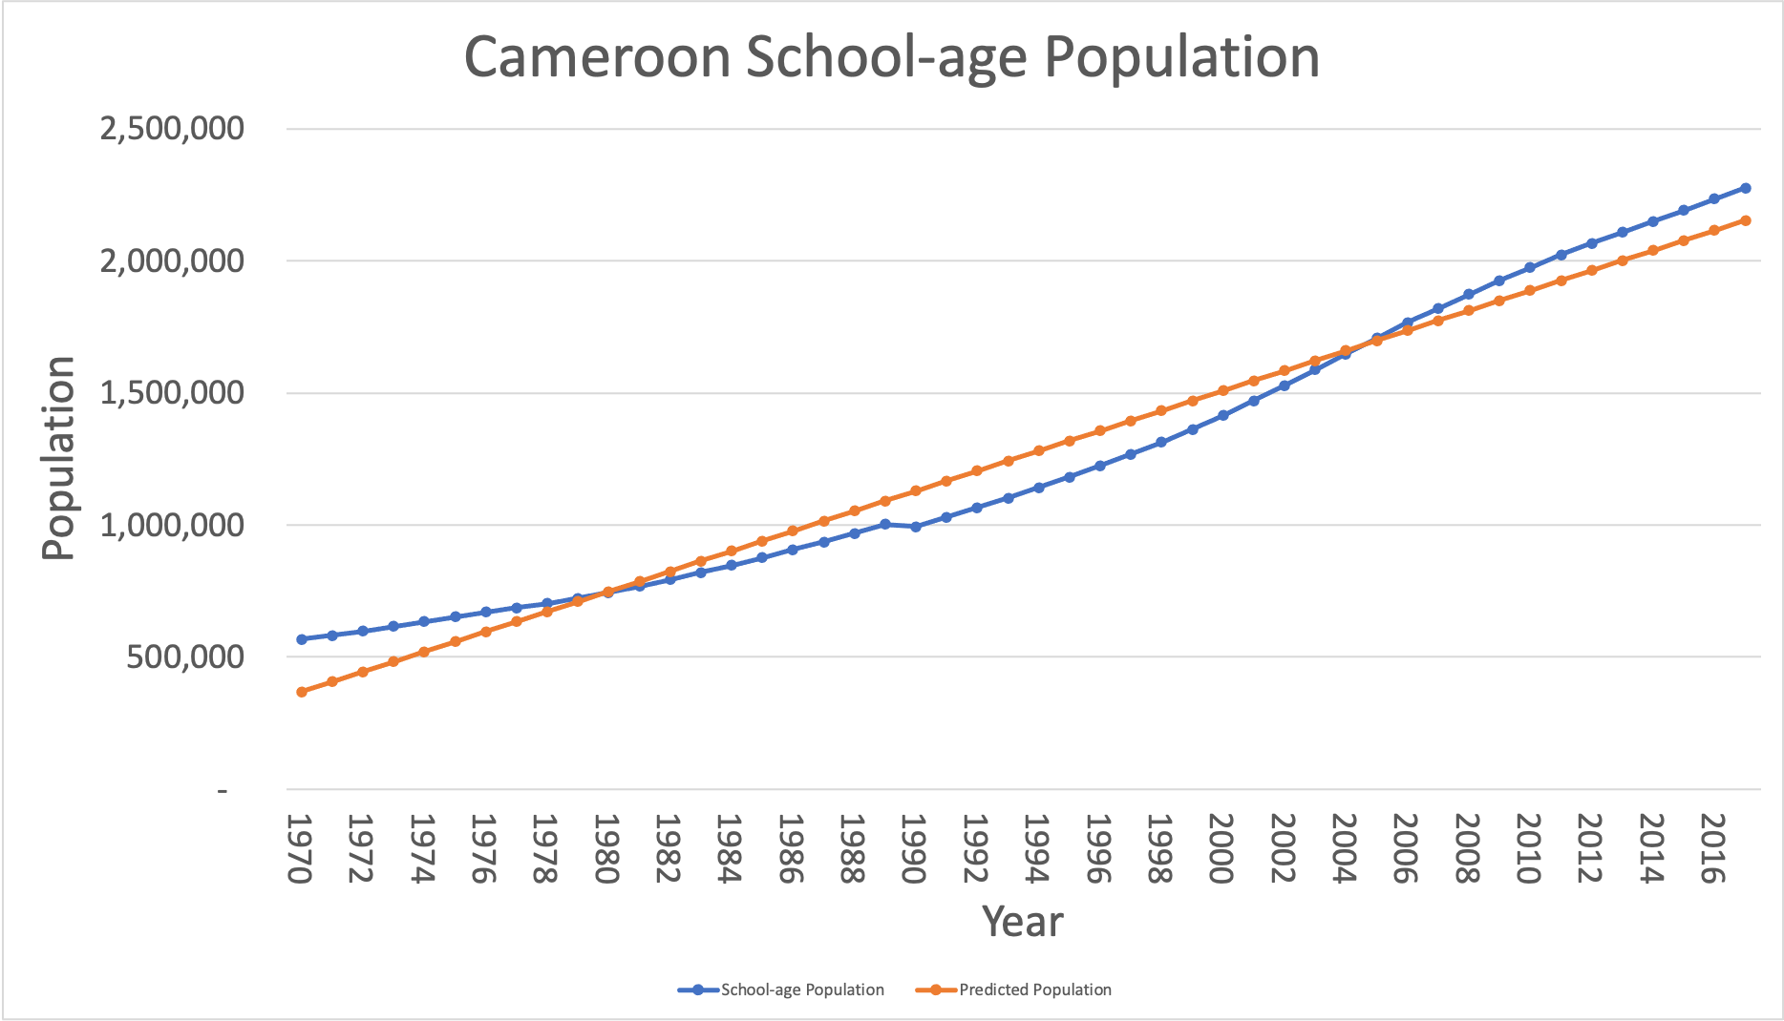
Achieving Business Goals with Predictive Analytics

Slide 30
Advanced Topics in Predictive Modeling
Predictive analytics is still a mix of art and science
Experimentation and heuristics (Algorithms) dominate the process
In predictive analytics, the goal is to develop models that are
Highly predictive (on holdout data)
Unbiased (objective for all outcomes)
Interpretable (transparent and explainable)
Computationally efficient
Robust and scalable
Easily deployable

Slide 31
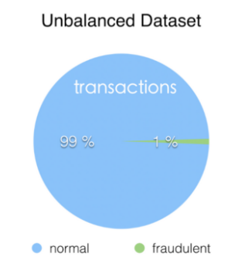
Imbalanced Data Problem
A dataset with severely imbalanced class (i.e., target variables values) distribution
Good Vs Bad Transactions

Slide 32
Imbalanced Data Problem
One of the critical and often unnoticed problems in predictive analytics
It leads to the concept called “fool’s gold”
You get a very high overall prediction accuracy for a classification problem
Predictions accuracy is dominated by the sheer count of the records coming from the majority class
Result: the model is missing vast majority of the minority class predictions (most often accurate prediction of the minority class is the most critical)
Why do we have imbalanced data sets?
Why does it lead to poor prediction performance?

Slide 33
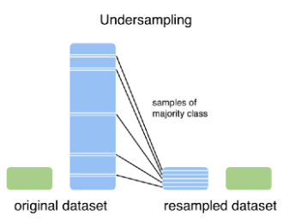
Undersampling
Under-Represented majority class

Slide 34
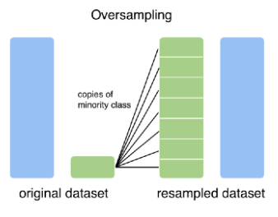
Oversampling
Over-Represented minority class
Notes:
Some alogarthism correct for this, but you could change your approach or Collect more data from the minority class

Slide 35

Musical Ensemble

Slide 36
Model Ensembles
Also called ensemble models
They are relatively new to predictive modeling
Historically, used under “combining forecasts”
Outcomes of two or more models are combined
Combined prediction outcomes are
More robust (don’t miss the target by a large margin)
More stable and reliable
More accurate
Work together
Better results
Notes:
Ensemble modeling is a process where multiple diverse models are created to predict an outcome, either by using many different modeling algorithms or using different training data sets.
The ensemble model then aggregates the prediction of each base model and results in once final prediction for the unseen data.
The motivation for using ensemble models is to reduce the generalization error of the prediction.
As long as the base models are diverse and independent, the prediction error of the model decreases when the ensemble approach is used.
The approach seeks the wisdom of crowds in making a prediction. Even though the ensemble model has multiple base models within the model, it acts and performs as a single model.

Slide 37
Motivation – Why Ensemble?
The Wisdom of the Crowds
Better decisions are made via crowdsourcing
Combined outcome is better than the best one
Characteristics
Diversity of opinions
Independence
Decentralization
Aggregation

Slide 38
Disadvantages of Model Ensembles
Although they seem to be the gold standard for predictive modeling, they have both advantages and disadvantages:
Advantages
Accuracy
Robustness
Reliability
Coverage of complex relations
Disadvantages
Complexity
Computational intensity
Lack of transparency
Difficult to deploy

Slide 39

Q&A
What questions and comments do you have?

Slide 40
Predictive Analytics Use - Retail
Retail/Consumer
Merchandizing and market basket analysis
Campaign management and customer loyalty programs
Supply-chain management and analytics
Event- and behavior-based targeting
Market and consumer segmentations
Financial Services
Compliance and regulatory reporting
Risk analysis and management
Fraud detection and security analytics
CRM and customer loyalty programs
Credit risk, scoring and analysis
High speed arbitrage trading
Trade surveillance
Abnormal trading pattern analysis

Slide 41
Predictive Analytics Use – Banking and Healthcare
Web & Digital Media Services Use Cases
Large-scale clickstream analytics
Ad targeting, analysis, forecasting and optimization
Abuse and click-fraud prevention
Social graph analysis and profile segmentation
Campaign management and loyalty programs
Health & Life Sciences Use Cases
Clinical trials data analysis
Disease pattern analysis
Campaign and sales program optimization
Patient care quality and program analysis
Medical device and pharma supply-chain management
Drug discovery and development analysis

Slide 42
Predictive Analytics Use Case by Industry
Telecommunications
Revenue assurance and price optimization
Customer churn prevention
Campaign management and customer loyalty
Call detail record (CDR) analysis
Network performance and optimization
Mobile user location analysis
Government
Fraud detection
Threat detection
Cybersecurity
Compliance and regulatory analysis

Slide 43
Predictive Analytics Use Case by Industry
E-Commerce
Cross-channel analytics
Event analytics
Recommendation engines using predictive analytics
Right offer at the right time
Next best offer or next best action

Slide 44
Predictive Analytics Use – Customer Managment
Predicting Lifetime Value (LTV)
Supports customer segmentation
Wallet share estimation
How much does a customer spend at my store
Identifies upsell opportunities
Supports other marketing initiatives
upsell and cross-sell opportunities

Slide 45
Predictive Analytics Use Case – Customer
Churn
Characteristics of churners allows a company to do product adjustments and reach out to churners
Customer segmentation
Different treatments
Answers questions like what makes people buy, stop buying etc.

Slide 46
Predictive Analytics Use Case - Marketing
Product mix
What mix of products offers the lowest churn?
Cross selling/Recommendation algorithms/
Given a customer's past browsing history, purchase history and other characteristics, what are they likely to want to purchase in the future?
eg. Giving a combined policy discount for home + auto = low churn

Slide 47
Predictive Analytics Use Case - Marketing
Discount targeting
What is the probability of inducing the desired behavior with a discount
Reactivation likelihood
What is the reactivation likelihood for a given customer

Slide 48
Predictive Analytics Use Case - Sales
Lead prioritization
What is a given lead's likelihood of closing
Revenue impact: supports growth
Demand forecasting
How many of what thing do you need and where will we need them?
Revenue impact: supports growth and militates against revenue leakage
Enables lean inventory and prevents out of stock situations.

Slide 49
Predictive Analytics Use Case - Risk
Credit risk
Treasury or currency risk
How much capital do we need on hand to meet these requirements?
Fraud detection
predicting whether or not a transaction should be blocked because it involves some kind of fraud (e.g. credit card fraud)
Accounts Payable Recovery
Predicting the probably a liability can be recovered given the characteristics of the borrower and the loan
Assign a risk score

Slide 50
Predictive Analytics Use Case - Customer support
Call centers
Call routing (ie determining wait times) based on caller id history, time of day, call volumes, products owned, churn risk, LTV, etc.
Call center message optimization
Putting the right data on the operator's screen
Call center volume forecasting
Predicting call volume for the purposes of staff rostering

Slide 51
Predictive Analytics Use Case - Human Resources
Resume screening
Scores resumes based on the outcomes of past job interviews and hires
Employee churn
Predicts which employees are most likely to leave
Training recommendation
Recommends specific training based of performance review data
Talent management
Looking at objective measures of employee success

Slide 52
Predictive Analytics Use Case - Healthcare
Claims review prioritization
Payers picking which claims should be reviewed by manual auditors
Medicare & Medicaid fraud
Tackled at the claims processors
Medical resources allocation
Hospital operations management
Optimize/predict operating theatre & bed occupancy based on initial patient visits

Slide 53
Predictive Analytics Use Case - Healthcare
Prescription compliance
Predicting who won't comply with their prescriptions
Physician attrition
Hospitals want to retain Drs who have admitting privileges in multiple hospitals
Survival analysis
Analyze survival statistics for different patient attributes (age, blood type, gender, etc.) and treatments
Medication (dosage) effectiveness
Analyse effects of admitting different types and dosage of medication for a disease
Readmission risk
Predict risk of re-admittance based on patient attributes, medical history, diagnose & treatment

Slide 54
Predictive Analytics Use Case - Retail
Pricing
Optimize per time period, per item, per store
Location of new stores
Site Selection (ex. new restaurant or coffee shop)
Product layout in stores
Where to place products for maximum exposure
Merchandizing
When to start stocking & discontinuing product lines

Slide 55
Predictive Analytics Use Case - Retail
Inventory Management (how many units)
Perishable goods
Shrinkage analytics
Theft analytics/prevention
Warranty Analytics
Rates of failure for different components
And what are the drivers or parts?
What types of customers buying what types of products are likely to redeem a warranty?

Slide 56
Application Case: To Imprison or Not to Imprison—A Predictive Analytics-Based DSS for Drug Courts
Use of predictive analytic in social context for behavioral problems has been rare, at best
As the digitized data become readily available, these domains have also ventured into discovering new and actionable insight via predictive analytics and data science
In this application case, a large and feature rich data is used to develop decision support systems for drug courts

Slide 57
Demo:
Topics
Student Q&A
Notes:
outline for a demo, if applicable

